Slide 1
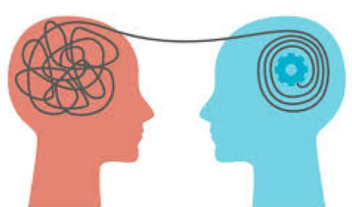
Empathy

Slide 2
What is Empathy?
Empathy is the ability to understand and share the feelings of others. It involves recognizing emotions, putting yourself in someone else’s shoes, and responding with compassion.

Slide 3
Key Aspects of Empathy
Understanding:
Recognizing and being aware of another person's emotions, even if you haven't experienced them yourself.
Sharing:
Feeling a connection to their emotions and responding to them in a meaningful way.
Perspective-Taking:
Imagining yourself in their situation and considering their unique viewpoint.
Skill and Trait:
While people are born with a capacity for empathy, it can also be developed and strengthened through practice and awareness.

Slide 4
Importance of Empathy
Building Relationships:
It allows for genuine connection, intimacy, and a sense of belonging in human relationships.
Promoting Understanding:
Empathy helps people feel understood and less alone, fostering a more compassionate and supportive environment.
Guiding Actions:
By understanding others' suffering, empathy makes it difficult to ignore it and motivates individuals to respond appropriately.

Slide 5
Importance of Empathy
• Builds trust and stronger relationships
• Enhances communication and understanding
• Reduces conflicts and promotes harmony
• Encourages kindness and support
• Creates inclusive and positive environments

Slide 6
Here are 10 points about empathy
:
Understanding, Not Just Feeling:
Empathy goes beyond simply feeling sorry for someone; it involves intellectually and emotionally understanding their experience.
Active Listening:
To be empathetic, you must fully focus on the speaker, giving them your complete attention without interrupting or planning your response.
Perspective-Taking:
This involves actively trying to see the world from another person's viewpoint, putting yourself in their shoes to grasp their situation and feelings.
Non-Verbal Communication:
Pay attention to body language and facial expressions, as these non-verbal cues often reveal emotions that words alone cannot express.
Open-Ended Questions:
Ask questions that encourage deeper sharing, such as "What has this been like for you?" or "How has this made you feel?".

Slide 7
Non-Judgmental Attitude:
Set aside personal judgments to create a safe space for others to express their thoughts and feelings without fear of criticism.
Self-Reflection:
Regularly reflect on your own feelings and actions. Understanding your emotions helps you better understand and connect with others.
Emotional Intelligence:
Empathy is a core component of emotional intelligence, which is vital for healthy social interactions and relationships.
Builds Trust and Connection:
Empathic individuals foster strong bonds by making others feel understood and valued, leading to deeper trust and more meaningful connections.
Promotes Positive Environments:
In professional settings, empathy can lead to better teamwork, improved communication, and a healthier work environment for everyone.

Slide 8
Empathy is characterized by the 3 C's of care, connect, and communicate.
The 3 C's of empathy are Care, Connect, and Communicate, representing the fundamental steps to understanding and responding to another person's feelings. Empathy requires cultivating a caring attitude, forming a genuine connection, and effectively communicating that understanding to the other person.

Slide 9
Care:
This is the foundational attitude of empathy, showing a genuine concern for another person's well-being and situation. It involves an internal motivation to understand and help.

Slide 10
Connect:
This involves making a genuine connection with the other person, showing them that you are present and engaged with their feelings. It's about building a relational foundation before offering advice.

Slide 11
Communicate:
After connecting, you must effectively communicate that you understand and care about their perspective and feelings. This involves checking for accuracy and ensuring your understanding is correct.

Slide 12
Types of Empathy
• Cognitive Empathy – Understanding others’ thoughts and perspectives
• Emotional Empathy – Sharing and feeling others’ emotions
• Compassionate Empathy – Taking action to help others

Slide 13
Cognitive Empathy
Cognitive empathy is the ability to understand another person's mental state, thoughts, and feelings by taking their perspective, often referred to as "putting yourself in their shoes". This differs from affective empathy, which is about sharing or feeling another's emotions. Cognitive empathy is a key social cognition skill essential for functioning in a complex social world and can be learned and improved with practice.

Slide 14
How it works
Perspective-Taking:
Cognitive empathy relies on your ability to imagine what it's like to be in someone else's situation and understand their point of view.
Mentalizing:
It's also associated with theory of mind (ToM) or mentalizing, the capacity to attribute mental states to oneself and others.
Intellectual Approach:
This type of empathy is an intellectual process of understanding, rather than a direct emotional response to another person's feelings.

Slide 15
Examples of Cognitive Empathy
Recognizing that a friend is disappointed after a job rejection and saying, "I know you're sad, and what you're going through is hard".
Understanding why a colleague might be resentful after someone less qualified received a promotion.
During a negotiation, understanding the other party's needs and motivations without necessarily feeling their stress.

Slide 16
Importance and Development
Social Functioning:
Cognitive empathy is crucial for successful social interaction and adapting to social environments.
Learnable Skill:
Unlike affective empathy, which may come more naturally to some, cognitive empathy is a skill that can be developed and improved with deliberate effort and practice.
Practical Applications:
Cognitive empathy is vital in various professional settings, like leadership, as it enables individuals to better understand and respond to others' needs and behaviors.

Slide 17
Emotional Empathy
Emotional empathy, or affective empathy, is the ability to feel and share the emotions of another person as if they were your own. It is a deep, intuitive, and contagious response that often manifests as a mirroring of the other person's feelings, a sense of being in sync with them, or a personal distress in response to their pain. This emotional connection can motivate a desire to help or comfort them, though it can also be overwhelming at times.

Slide 18
How it Works
Emotional Contagion:
You are affected by another person's emotional or arousal state, which creates a shared feeling.
Mirroring:
You might unconsciously mimic the behaviors and emotional expressions of the other person.
Shared Experience:
You move from a cognitive understanding of their situation to an actual shared emotional state.

Slide 19
Examples of Emotional Empathy
Seeing a loved one cry: and feeling your own sadness in response.
Watching a sad movie: and feeling the character's sorrow.
Hearing about a friend's triumph: and genuinely feeling happy for them.

Slide 20
Benefits and Drawbacks
Benefits:
Fosters deep connections, strengthens interpersonal relationships, and motivates compassionate behavior and helping others.
Drawbacks:
It can be overwhelming and contagious, leading to a person taking on unnecessary feelings or becoming emotionally drained

Slide 21
Compassionate Empathy
Compassionate empathy is the ability to understand another person's feelings and circumstances, and to be motivated to act to help improve their situation. It combines cognitive empathy (understanding) with a compassionate desire to alleviate suffering, moving beyond merely feeling another's pain to taking supportive action.

Slide 22
Components of Compassionate Empathy
Cognitive Empathy: The ability to understand someone's perspective and feelings, seeing the world through their eyes.
Emotional Resonance: Feeling a connection to what the other person is experiencing.
Motivation to Help: A desire to take action to improve the other person's well-being and relieve their suffering.

Slide 23
Why Compassionate Empathy is Important
It strengthens human connections by showing genuine care and interest in another's well-being.
It allows for constructive support, as you understand the situation and are motivated to find a solution.
It moves past self-centeredness, leading to actions that are morally and ethically fair for the other person.

Slide 24
Barriers to Empathy
• Prejudices and stereotypes
• Lack of awareness or self-centeredness
• Stress and emotional exhaustion
• Poor listening skills
• Cultural and communication differences

Slide 25
Internal Barriers
Fear and Insecurity:
Fear of rejection, failure, or not knowing the right thing to say can prevent empathetic connection.
Fatigue and Stress:
Being tired, overworked, or emotionally depleted reduces the mental capacity for empathy.
Cognitive Biases:
Prejudices, stereotypes, and in-group biases lead to biased judgments and assumptions, making it difficult to empathize with those perceived as different.
Lack of Self-Awareness:
Not being aware of your own thoughts, feelings, or biases can impede your ability to connect with others.
Judgment and Criticism:
Holding onto judgments or engaging in excessive criticism prevents you from understanding another's perspective.

Slide 26
External & Situational Barriers
Distractions:
Environmental distractions and constant digital notifications fragment attention, making it hard to focus on another person's needs.
Distance and Lack of Exposure:
Geographical or social distance, as well as a lack of exposure to diverse experiences, makes it harder to relate to people whose lives are different.
Time Constraints:
Feeling rushed or that there isn't enough time can limit the opportunity for deeper, empathetic engagement.
Communication Barriers:
Poor listening skills, poor choice of words, or cultural differences can create misunderstandings and block empathy.

Slide 27
Emotional & Interpersonal Barriers
Emotional State:
When feeling overwhelmed or distressed by one's own problems, it's difficult to have the mental or emotional space to empathize with others.
Poor Listening:
Failure to truly listen and acknowledge someone's feelings, rather than just hearing their words, is a major obstacle.
Emotional Detachment:
Disconnecting emotionally as a self-protective mechanism, while sometimes necessary for well-being, can hinder empathetic connection.

Slide 28
How to Develop Empathy
• Practice active listening
• Be open-minded and non-judgmental
• Observe body language and emotions
• Show compassion through actions
• Reflect on your own feelings and experiences

Slide 29
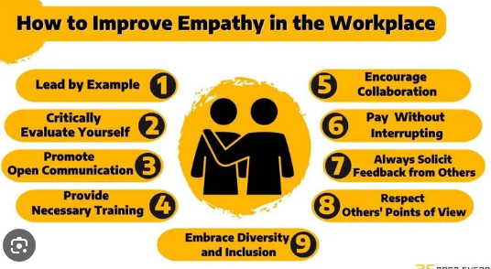

Slide 30


